Slide 1
Dr. Reshma Reghu
Lecturer,
Dept of Community Medicine

Slide 2
GOALS
Mortality & morbidity reduction
Increase in expectation of life
Decrease in provision of basic sanitation
Health manpower requirements & resource development
Other parameters like food production, literacy rate, reduced levels of poverty

Slide 3
Health services should be
Comprehensive
Accessible
Acceptable
Provide scope for community participation
Available at a cost the community & country can afford.

Slide 5
PRIVATE SECTOR
Private hospitals, Polyclinics, Nursing homes, Dispensaries
General practitioners & cliinics
INDIGENOUS SYSTEM OF MEDICINE
AYURVEDA & Siddha
Unani & Tibbi
Homoeopathy
Unregistered practitioners
VOLUNTARY HEALTH AGENCIES
NATIONAL HEALTH PROGRAMMES

Slide 8
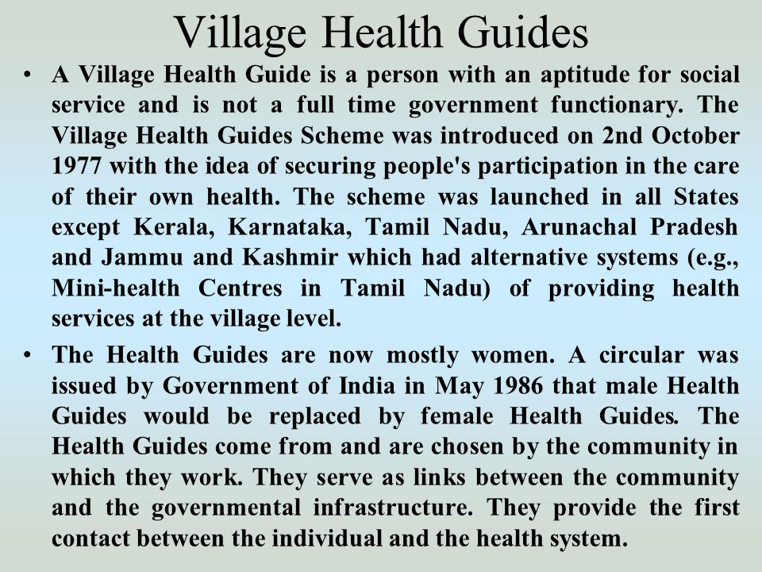

Slide 12
ANGANWADI WORKER
Under ICDS Scheme
1/400-800 population
100 workers in ICDS Project
6,719 ICDS blocks are functioning
Trained in health, nutrition and child development for 4 months
Part time worker and paid with an honorarium of 1500 per month
Services include maintanence of growth chart, immunisation, supplementary nutrition, , health education, and referral services.

Slide 13
ASHA (Accredited Social Health Activist)
Resident of village- a women of age group 25-45 years with formal education up to VIIIth class, having communication skills & leadership.
1/1000 population.
Will be a health activist in the community who will create awareness of health

Slide 14
Responsibilities
Create awareness & provide information on health
Counsel women regarding child care
Mobilize the community & facilitate them in accessing health & health related services available at certain centres & services provided by the government
Work with the village sanitation committee to develop a village health plan
Should arrange escort / accompany pregnant women & child to the nearest centres.
Should provide medical care to minor ailment.
Act as a depot holder for essential provision being made available to every habitation
Provide new born care & management of common illness
Inform about the birth & death in her village& any unusual health problems in the community to the centres.
Promote construction of household toilets under sanitation campaign.

Slide 15
SUB CENTRE LEVEL
health delivery system in rural areas
one centre for 5,000 population in general & one for every 3000 population in hilly, tribal areas.
As of March 2014, 1,52,326 sub- centres are established
Provide primary care services to the community.
Staffs-
One Female Health Worker (ANM)
One Male Health Worker
One female Health Assistant (LHV)
One Male Health Assistant

Slide 16
Indian Public Health Standards For Sub- Centres
Maternal Health Care
Ante natal care- Early Registration, Folic acid supplementation, TT Immunization, Identifying the High risk pregnancy, Counseling
Intranatal care- Promotion of institutional deliveries, skilled attendance at home deliveries, proper reference incase of complication
Postnatal Care- Min. 2 visit, initiation of breast feeding, Counseling
2. Child Health Care

Slide 17
3. Family Planning & Contraception
4. Counseling & appropriate measures for safe abortion services.
5. Adolescent health care
6. Assistance to school health services
7. Water quality monitoring
8. Promotion of sanitation.
9. Field visit
10. Community need assessment
11. Curative services for minor ailments
12. Training of Traditional Birth Attendants & ASHA/ Community health volunteers.
13. Co-ordinate service of Anganwadi workers, ASHA
14. National health programmes

Slide 19
5484 PHCs by 1980.
1/100000 population
In 1962, Recommendation from Mudaliar Committee, 1/40,000
In 1983, National Health Plan, one PHC/ 30,000 population.
As on March 2014, 25,020 PHCs have been established

Slide 21
Indian Public Health Standards For PHCs
The objectives of IPHS for PHCs
To provide comprehensive primary health care to the community through PHCs.
To achieve & maintain an acceptable standard of quality of acre
To make the services more responsive & sensitive to the needs of the community.

Slide 22
Minimum Requirements are
Medical Care
OPD services
24 hours emergency service
Referral services
In patient service
2. Maternal & Child Health Care
Ante natal Care
Intra natal care
Post Natal care
New born Care
Care of the child

Slide 23
3. Full range of Family Planning & referral for couples having infertility.
4. Medical termination of pregnancy with trained personnel / facility
5. Health Education for preventive & management of RTI & STI
6. Nutrition Services
7. Adolescent health care
8. School health service
9. Disease surveillance & Control of epidemics
10. Collection & reporting of vital events
11. Testing of Water quality & disinfection of water sources
12. Promotion of sanitation.
13. Appropriate & Prompt referral of cases needing special care.
14. Recording of vital events & maintenance of record
15. Basic laboratory services.
16. Training
17. Monitoring & Supervision
18. National health programme
19. Selected surgical procedures
20. Mainstreaming of AYUSH

Slide 25
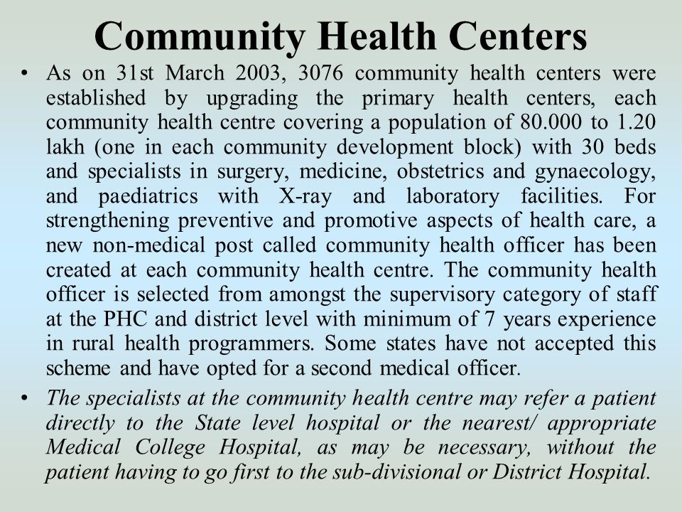

Slide 26
IPHS
Care of routine & emergency cases in surgery
Care of routine & emergency cases in medicine
24 hour health delivery service
Essential & emergency obstetric care
Full range of Family planning service
Safe abortion service
New born care
Routine & emergency care of sick children
Management like nasal packing, Tracheostomy etc
All National Health Programmes
Other Facility like Blood Storage, Laboratory service, Referral service

Slide 29
HOSPITALS
Rural Hospitals
District Hospitals
Chief Medical Officer
3 Deputy CMOs

Slide 30
Health Insurance
Employees State Insurance Scheme
Central Government Health Insurance Scheme

Slide 36
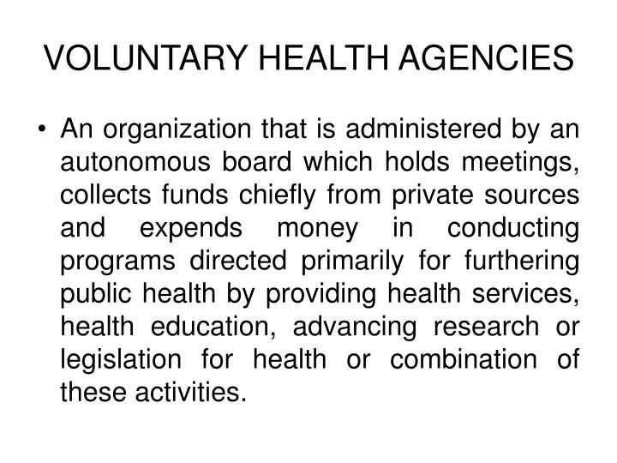

Slide 39
INDIAN RED CROSS SOCIETY
1920
400 Branches
Promotion of health, Prevention of disease & reduce the suffering .
Relief Work
Milk & Medical supply
Armed forces
Maternal & Child Welfare Services
Family Planning
Blood Bank & First Aid

Slide 43
BHARAT SEVAK SAMAJ

Slide 44
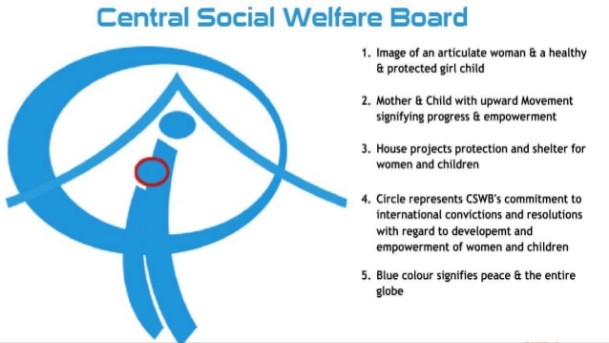

Slide 49
INTERNATIONAL AGENCIES
Rockefeller Foundation
Ford Foundation
CARE

Slide 50
HEALTH PROGRAMMES IN INDIA
NATIONAL HEALTH PROGRAMMES
Central Government
Eradication of communicable disease, Improving the Environmental sanitation, Nutrition, Control of population & Rural health.

